Slide 1
Introduction to Decision Trees for Classification
Course Code: CSC 4232
Course Title: Machine Learning
Dept. of Computer Science
Faculty of Science and Technology

Slide 2
Lecture Outline
Introduction to Decision Trees
The TDIDT Algorithm
Decision Tree Induction: Using Entropy for Attribute Selection

Slide 3
Introduction to Decision Trees
Lecture Objectives and Outcomes:
Familiar with the Decision Trees
The TDIDT (Top-Down Induction of Decision Trees) algorithm for inducing classification rules via the intermediate representation of a decision tree
Examines entropy based attribute selection strategy (equivalently maximising information gain) for selecting attributes at each stage of the TDIDT algorithm

Slide 4
Introduction to Decision Trees
In many fields, large collections of examples, possibly collected for other purposes, are readily available. Automatically generating classification rules (often called decision rules) for such tasks has proved to be a realistic alternative to the standard Expert System approach of eliciting the rules from experts.
The aim is to develop classification rules from the data in the training set. This is often done in the implicit form of a decision tree.

Slide 5
Introduction to Decision Trees
A decision tree is created by a process known as splitting on the value of attributes i.e. testing the value of an attribute and then creating a branch for each of its possible values.
In the case of continuous attributes the test is normally whether the value is ‘less than or equal to’ or ‘greater than’ a given value known as the split value.
The splitting process continues until each branch can be labelled with just one classification.

Slide 6
Introduction to Decision Trees
Training set and Decision tree are equivalent in the sense that for each of the instances the given values of all attributes in the training set will lead to the identical classifications.
Decision trees have two different functions: data compression and prediction.
It is important to stress that this ‘decision’ is only a prediction, which may or may not turn out to be correct.

Slide 7
Introduction to Decision Trees
Decision tree consists of a number of branches, each ending with a leaf node labelled with one of the valid classifications.
Each branch comprises the route from the root node (i.e. the top of the tree) to a leaf node.
A node that is neither the root nor a leaf node is called an internal node.

Slide 8
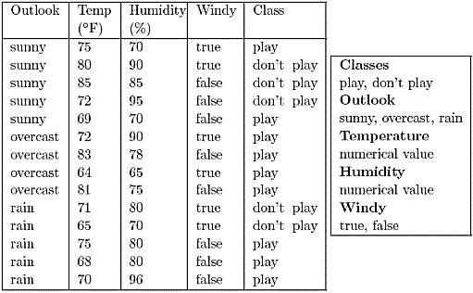
Decision Trees: The Golf Example
A fictitious example is that of a golfer who decides whether or not to play each day on the basis of the weather.
It shows the results of two weeks (14 days) of observations of weather conditions and the decision on whether or not to play.

Slide 9
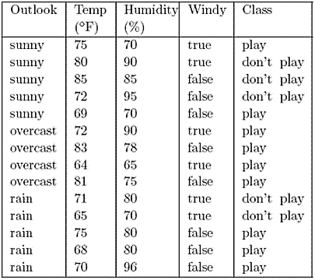
Decision Trees: The Golf Example
If tomorrow the values of Outlook, Temperature, Humidity and Windy were sunny, 74◦F, 77% and false respectively, what would the decision be?
One way of answering this is to construct a decision tree.

Slide 10
Decision Trees: The Golf Example
In order to determine the decision (classification) for a given set of weather conditions from the decision tree, first look at the value of Outlook. There are three possibilities.

Slide 11
Decision Trees: The Golf Example
If the value of Outlook is sunny, next consider the value of Humidity. If the value is less than or equal to 75 the decision is play. Otherwise the decision is don’t play.
If the value of Outlook is overcast, the decision is play.
If the value of Outlook is rain, next consider the value of Windy. If the value is true the decision is don’t play, otherwise the decision is play.

Slide 12
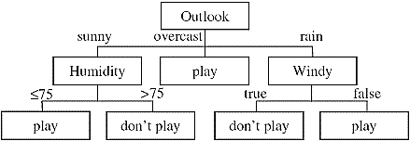
Decision Trees: The Golf Example
We call it a hypothetical decision tree.
Note that the value of Temperature is never used.
Notes:
Hypothetical tree

Slide 13
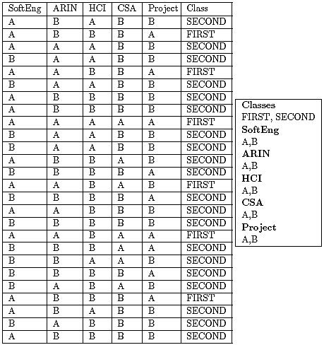
The degrees Dataset
The training set shown beside (taken from a fictitious university) shows the results of students for five subjects coded as SoftEng, ARIN, HCI, CSA and Project and their corresponding degree classifications, which in this simplified example are either FIRST or SECOND. There are 26 instances. What determines who is classified as FIRST or SECOND?

Slide 14
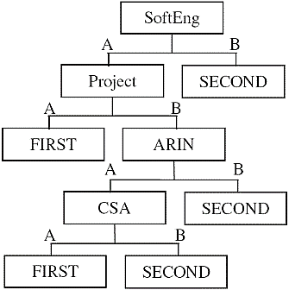
The degrees Dataset

Slide 15
The degrees Dataset
We can think of the root node as corresponding to the original training set. All other nodes correspond to a subset of the training set.
At the leaf nodes each instance in the subset has the same classification. There are five leaf nodes and hence five branches.

Slide 16
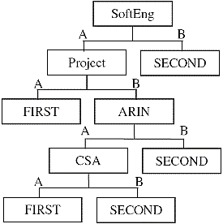
The degrees Dataset
Each branch corresponds to a classification rule. The five classification rules can be written in full as:
IF SoftEng = A AND Project = A THEN Class = FIRST
IF SoftEng = A AND Project = B AND ARIN = A AND CSA = A THEN Class = FIRST
IF SoftEng = A AND Project = B AND ARIN = A AND CSA = B THEN Class = SECOND
IF SoftEng = A AND Project = B AND ARIN = B THEN Class = SECOND
IF SoftEng = B THEN Class = SECOND

Slide 17
The degrees Dataset
IF SoftEng = A AND Project = A THEN Class = FIRST
The left-hand side of each rule (known as the antecedent) comprises a number of terms joined by the logical AND operator.
Each term is a simple test on the value of a categorical attribute (e.g. SoftEng = A) or a continuous attribute (e.g. in Figure 3.2, Humidity > 75).
A set of rules of this kind is said to be in Disjunctive Normal Form (DNF). The individual rules are sometimes known as disjuncts.
The order in which we write the rules generated from a decision tree is arbitrary. We can rearrange the rules without any change to the predictions the ruleset will make on unseen instances.

Slide 18

The degrees Dataset
Each instance in the original degrees training set could be viewed as a rule, for example IF SoftEng = A AND ARIN = B AND HCI = A AND CSA = B AND Project = B THEN Class = SECOND
There are 26 such rules, one per instance, each with five terms, making a total of 130 terms.
The decision tree can be written as five decision rules with a total of 14 terms, an average of 2.8 terms per rule.
Even for this very small training set, the reduction in the number of terms requiring to be stored from the training set (130 terms) to the decision tree (14 terms) is almost 90%.

Slide 19
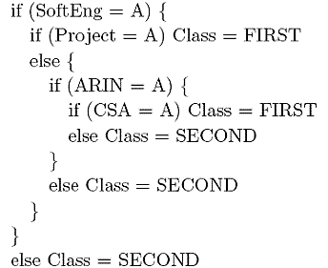
The degrees Dataset
For practical use, the rules can easily be simplified to an equivalent nested set of IF . . . THEN . . . ELSE rules, with even more compression

Slide 20
The TDIDT Algorithm
Decision trees are widely used as a means of generating classification rules because of the existence of a simple but very powerful algorithm called TDIDT, which stands for Top-Down Induction of Decision Trees.
The method produces decision rules in the implicit form of a decision tree. Decision trees are generated by repeatedly splitting on the values of attributes. This process is known as recursive partitioning.

Slide 21
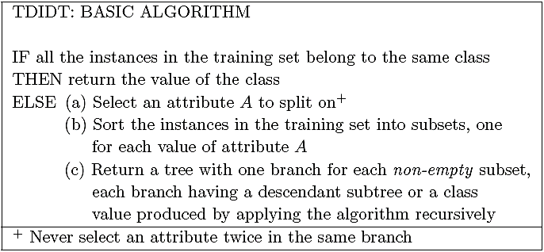
The TDIDT Algorithm

Slide 22
The TDIDT Algorithm
At each non-leaf node an attribute is chosen for splitting. This can potentially be any attribute, except that the same attribute must not be chosen twice in the same branch.
This restriction has a very valuable effect. Each split on the value of an attribute extends the length of the corresponding branch by one term, but the maximum possible length for a branch is M terms where there are M attributes. Hence the algorithm is guaranteed to terminate.
A major problem with the TDIDT algorithm, which is not apparent at first sight, is that it is underspecified. The algorithm specifies ‘Select an attribute A to split on’ but no method is given for doing this.

Slide 23
Decision Tree Induction: Using Entropy for Attribute Selection

Slide 24
Attribute Selection: An Experiment
It was shown that the TDIDT algorithm is guaranteed to terminate and to give a decision tree that correctly corresponds to the data, provided that the adequacy condition is satisfied.
It was also pointed out that the TDIDT algorithm is underspecified.
Provided that the adequacy condition is satisfied, any method of choosing attributes will produce a decision tree.
We will start our discussion by considering the decision trees obtained from using some poorly chosen strategies for attribute selection.

Slide 25
Attribute Selection: An Experiment
First, examine at the decision trees produced by using the three attribute selection strategies listed below.
takefirst – for each branch take the attributes in the order in which they appear in the training set, working from left to right, e.g. for the degrees training set in the order SoftEng, ARIN, HCI, CSA and Project.
takelast – as for takefirst, but working from right to left, e.g. for the degrees training set in the order Project, CSA, HCI, ARIN and SoftEng.
random – make a random selection (with equal probability of each attribute being selected).

Slide 26
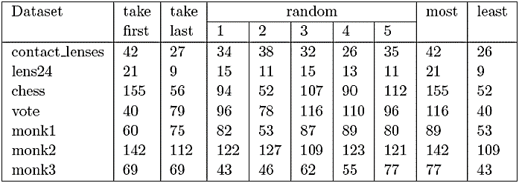
Attribute Selection: An Experiment
Table below shows the results of running the TDIDT algorithm with attribute selection strategies takefirst, takelast and random in turn to generate decision trees for the seven datasets contact lenses, lens24, chess, vote, monk1, monk2 and monk3.

Slide 27
Attribute Selection: An Experiment
The random strategy was used five times for each dataset. In each case the value given in the table is the number of branches in the decision tree generated. The last two columns record the number of branches in the largest and the smallest of the trees generated for each of the datasets.

Slide 28
Attribute Selection: An Experiment
In all cases there is a considerable difference. This suggests that although in principle the attributes can be chosen in any arbitrary way, the difference between a good choice and a bad one may be considerable.

Slide 29
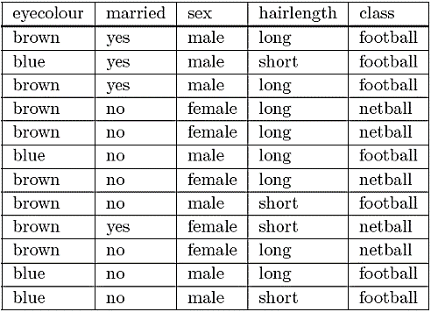
The Football/Netball Example
A fictitious university requires its students to enroll in one of its sports clubs, either the Football Club or the Netball Club. It is forbidden to join both clubs. Any student joining no club at all will be awarded an automatic failure in their degree.
What determines who joins which club?

Slide 30
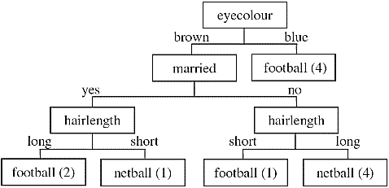
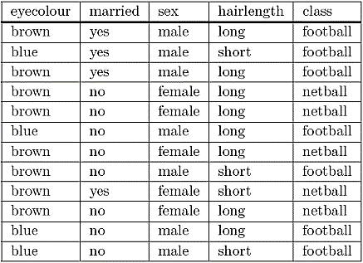
The Football/Netball Example

Slide 31
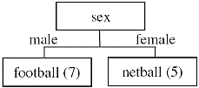
The Football/Netball Example

Slide 32
The Football/Netball Example
Which one is correct?
It is best to avoid using terms such as ‘correct’ and ‘incorrect’ in this context.
All we can say is that both decision trees are compatible with the data from which they were generated.
The only way to know which one gives better results for unseen data is to use them both and compare the results.

Slide 33
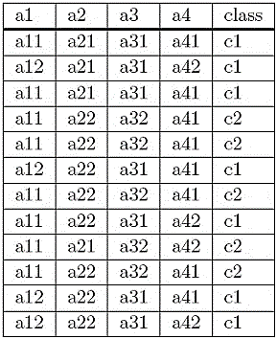
The anonymous Dataset
Now consider a different dataset. Here we have a training set of 12 instances. There are four attributes, a, a2, a3 and a4, with values a11, a12 etc., and two classes c1 and c2.
One possible decision tree?

Slide 34
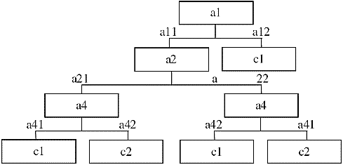
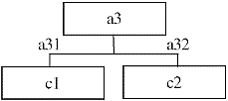
The anonymous Dataset

Slide 35
The anonymous Dataset
Data mining algorithms generally do not allow the use of any background knowledge the user has about the domain from which the data is drawn, such as the ‘meaning’ and relative importance of attributes, or which attributes are most or least likely, to determine the classification of an ins
It is easy to see that a decision tree involving tests on eyecolour, hairlength etc. is meaningless when it is given in isolation, but if those attributes were part of a much larger number (possibly many thousands) in a practical application what would there be to prevent meaningless decision rules from being generated?
The quality of the strategy used to select the attribute to split on at each stage is clearly of vital importance. This is the topic to which we now turn.

Slide 36
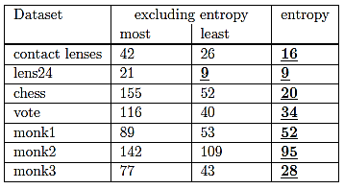
Entropy
One commonly used method is to select the attribute that minimises the value of entropy, thus maximizing the information gain.

Slide 37
Why Entropy/Information Gain
In all cases the number of rules in the decision tree generated using the ‘entropy’ method is less than or equal to the smallest number generated using any of the other attribute selection criteria introduced so far. In some cases, such as for the chess dataset, it is considerably fewer.
There is no guarantee that using entropy will always lead to a small decision tree, but experience shows that it generally produces trees with fewer branches than other attribute selection criteria. Experience also shows that small trees tend to give more accurate predictions than large ones, although there is certainly no guarantee of infallibility.

Slide 38
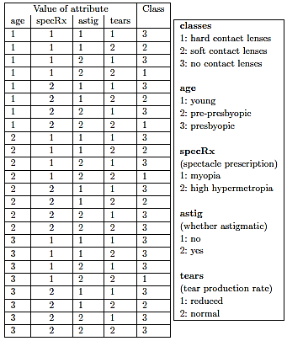
Lens24 Dataset
The lens24 dataset is Ophthalmological data about contact lenses.
Three classes 1, 2 and 3 - signifying respectively that the patient should be fitted with hard contact lenses, soft contact lenses or none at all

Slide 39
Information Gain
Information Gain, IG = E_{start} – E_{new}
E_{start} entropy of the training set, It is measured in ‘bits’ of information and is defined by the formula
E_{new} is calculated for each attribute
We get an attribute’s IG value by subtracting its E_{new} from E_{start}
Attribute with highest IG value is selected

Slide 40
Entropy
For the initial lens24 training set of 24 instances, there are 3 classes.
There are 4 instances with classification 1, 5 instances with classification 2 and 15 instances with classification 3.
So p1 = 4/24, p2 = 5/24 and p3 = 15/24.
E_{start} = −(4/24) log₂(4/24) − (5/24) log₂(5/24) − (15/24) log₂(15/24)= 0.4308 + 0.4715 + 0.4238 = ?

Slide 41
Select Attribute
The process of decision tree generation by repeatedly splitting on attributes is equivalent to partitioning the initial training set into smaller training sets repeatedly, until the entropy of each of these subsets is zero.
Splitting on any attribute has the property that the average entropy of the resulting subsets will be less than (or occasionally equal to) that of the previous training set.

Slide 42
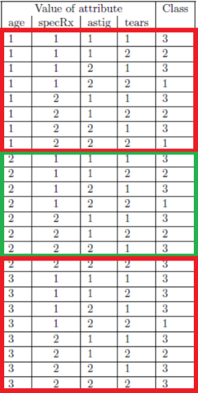
Splitting on Attribute
For the lens24 training set, splitting on attribute age would give three subsets as shown

Slide 43
Splitting on Attribute
Age = 1
Entropy E1 = −(2/8) log₂(2/8) − (2/8) log₂(2/8) − (4/8) log₂(4/8) = 0.5 + 0.5 + 0.5 = 1.5

Slide 44
Splitting on Attribute
Age = 2
Entropy E2 = −(1/8) log₂(1/8) − (2/8) log₂(2/8) − (5/8) log₂(5/8) = 0.375 + 0.5 + 0.4238 = 1.2988

Slide 45
Splitting on Attribute
Age = 3
Entropy E3 = −(1/8) log₂(1/8) − (1/8) log₂(1/8) − (6/8) log₂(6/8) = 0.375 + 0.375 + 0.3113 = 1.0613

Slide 46
Splitting on Attribute
The values E1, E2 and E3 need to be weighted by the proportion of the original instances in each of the three subsets. In this case all the weights are the same, i.e. 8/24.
E_{new} = (8/24) E1+(8/24) E2+(8/24) E3 = 1.2867 bits (4 decimal)
Information Gain = E_{start} − E_{new}
Information gain from splitting on attribute age is 1.3261 − 1.2867 = 0.0394 bits
The ‘entropy method’ of attribute selection is to choose to split on the attribute that gives the greatest reduction in (average) entropy, i.e. the one that maximises the Information Gain. This is equivalent to minimizing the value of E_{new} as E_{start} is fixed.

Slide 47
Splitting on Attribute
attribute age
E_{new} = 1.2867, Information Gain = 1.3261 − 1.2867 = 0.0394 bits
attribute specRx
E_{new} = 1.2866, Information Gain = 1.3261 − 1.2866 = 0.0395 bits
attribute astig
E_{new} = 0.9491, Information Gain = 1.3261 − 0.9491 = 0.3770 bits
attribute tears
E_{new} = 0.7773, Information Gain = 1.3261 − 0.7773 = 0.5488 bits

Slide 48
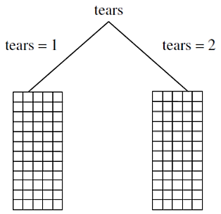
Splitting on Attribute
Thus, the largest value of Information Gain (and the smallest value of the new entropy E_{new}) is obtained by splitting on attribute tears.
The process of splitting on nodes is repeated for each branch of the evolving decision tree, terminating when the subset at every leaf node has entropy zero.

